Slide 1




Pi-Mates
HACKTOBERFEST 1.0

Slide 2






Movie Recommendation System
In an era filled with unlimited streaming services and countless movie options, our movie recommendation system addresses the challenge of finding enjoyable content. Our target audience experiences decision fatigue when trying to select a movie to watch, which is why the problem we aim to solve is overwhelming choice. This relevant and important issue directly affects the consumer's experience.
In the year 2021, roughly 51% of American consumers were found to be feeling overwhelmed by the staggering amount of streaming services and entertainment options at their disposal, as per the Deloitte Digital Media Trends survey. Additionally, according to the Hub Research study, 38% of individuals found themselves wasting more time on selecting what to watch rather than actually viewing content. These statistics highlight a substantial desire for an effective solution that can streamline the decision-making process and furnish customized movie suggestions to heighten the overall viewing pleasure

Slide 3




Solution
In short, our business model solves the overwhelming movie choice problem with personalized recommendations, content aggregation, and user engagement. We also incorporate a social impact component, making it a sustainable solution for the tech industry.
Our innovative business strategy offers the following solutions:
Personalized Movie Recommendations:
2. Content Aggregation:
3. User Engagement:

Slide 4


Key Features and Functionality
Our system offers a user-friendly interface with intuitive navigation and a powerful search function for easy content discovery.

Slide 5


Social impact
Social Impact Goals:
Promote diversity in film
2. Foster a strong film community.
Measuring Social Impact:
Track underrepresented content.
2. Measure community engagement.

Slide 6


Revenue Model
Revenue Model:
- Pay – per – click advertising
- Content Partnerships
Social Impact:
Promoting diversity in film.
2 Building a strong film community.
Our business model creates a better world by fostering inclusivity, sustainability, and community in the film industry.

Slide 7



Technologies Used
OUR TEAM UTILIZED A VARIETY OF TECHNOLOGIES INCLUDING PROGRAMMING LANGUAGES LIKE AND PYTHON, HTML, CSS AND JAVASCRIPT, AS WELL AS TOOLS LIKE GITHUB PANDAS AND APIs

Slide 8

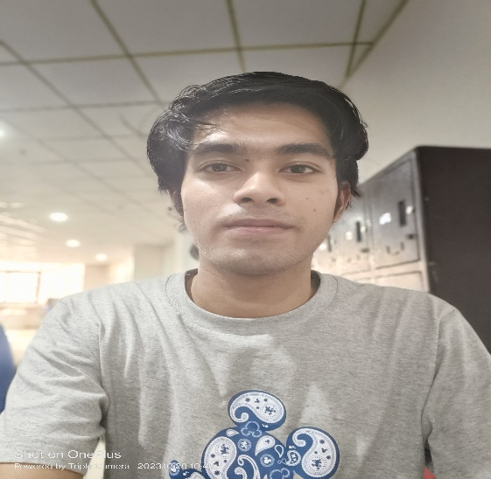
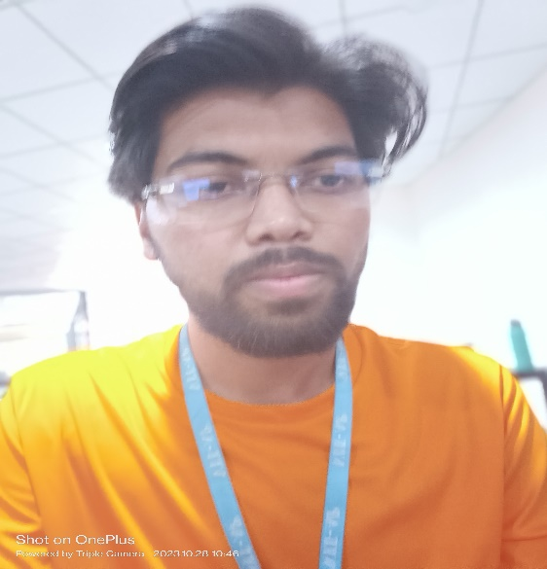
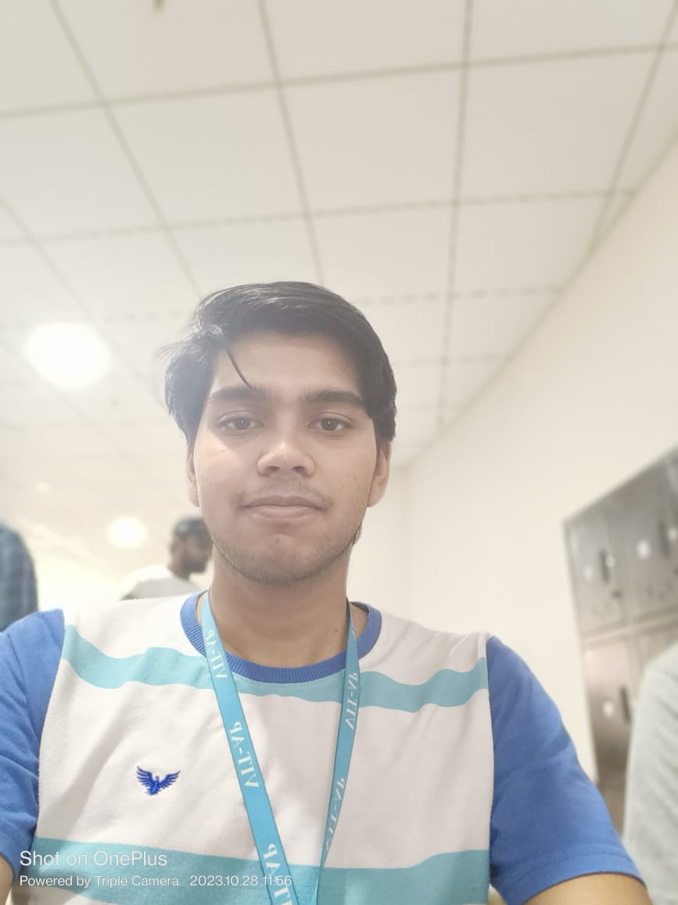
478014
The Team
Tarush Saxena
Vansh Rawat
Kartikay Singh
developer
developer
developer

Slide 9


Thank You
HACKTOBER FEST

